Slide 1

Chaining Comparison Operators

Slide 2
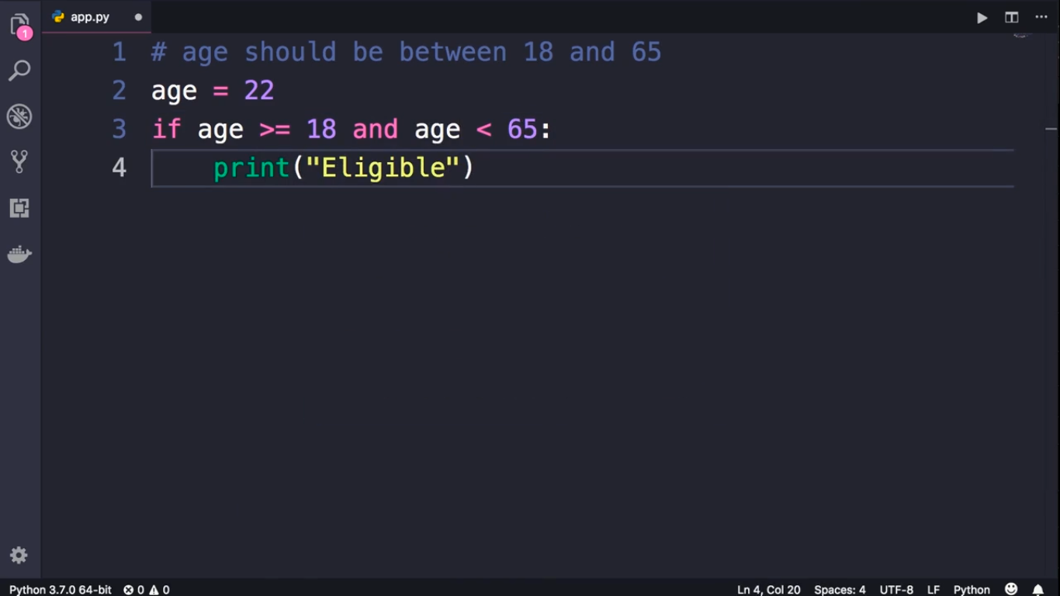

Slide 3
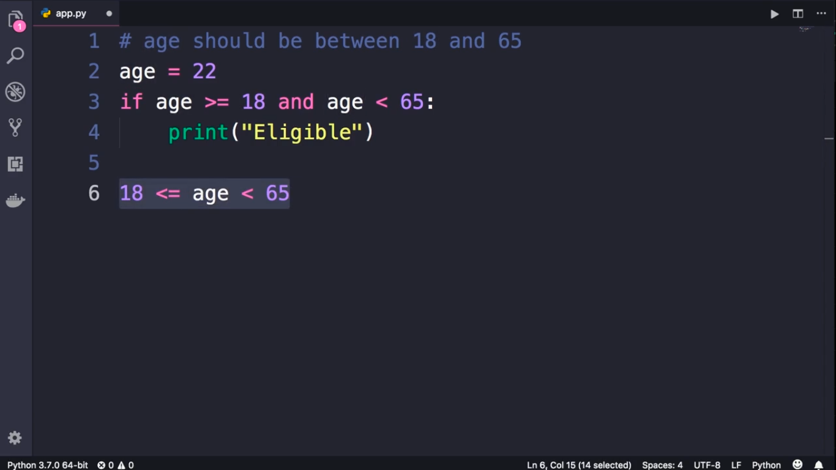
We write this style in Math.

Slide 4
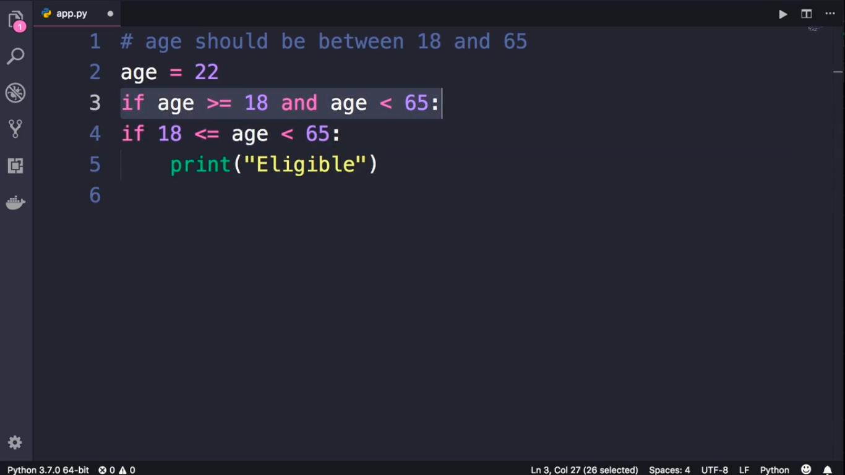

Slide 5
